Slide 1

DSA Project
Social Network Intelligence Engine (SNIE)- Project
Project Members :
Ved Mitra Verma - B24CS1086
Aditya Sharma - B24CS1119
Sarse Rohan Madhav - B24EE1090
Chhatrala Darsh Navneetbhai - B24EE1094

Slide 2
Problem Statement
Modern social and professional networks are increasingly large, complex, and dynamic, making it difficult to understand structural patterns, identify key influencers, or optimize connectivity for efficient information flow. Existing analytical systems often focus on isolated tasks—such as community detection, centrality analysis, or recommendation—without providing a unified framework that links structural intelligence with real-time optimization.
There is a need for an integrated system that can analyze network structure, infer meaningful relationships, and recommend connections that enhance cohesiveness, reduce fragmentation, and improve the overall efficiency of information spread.

Slide 3
Project Overview
The Social Network Intelligence Engine (SNIE) is an analytical framework designed to understand, interpret, and optimize connectivity within social, professional, or collaborative networks. In this system, nodes represent individuals or entities, while edges capture the strength and semantics of their relationships. SNIE integrates graph-theoretic analysis, influence scoring, and weighted relationship modeling to detect communities, identify key connectors, reveal structural gaps, and recommend impactful local and cross-community links. Through this unified approach, the engine enhances network cohesiveness and improves overall information flow.

Slide 4
Key Features of SNIE
Offline Structural Intelligence: Community detection and Betweenness Centrality (BC)
Real-Time Local Intelligence: Weighted Dijkstra paths and semantic scoring
Global Optimization: Cross-community bridge recommendations
Visualization: Communities, influence, weighted ties, and bridge simulations
Information Spread Simulation (Addendum): Pre- and post-bridge cost measurement

Slide 5
Goals and Objectives
Analyze network structure by detecting communities, clusters, and isolated components.
Identify influential nodes using Betweenness Centrality to understand control points in information flow.
Interpret relationship semantics through weighted edges representing tie strength and domain similarity.
Provide intelligent local recommendations based on proximity, semantic scoring, and influence metrics.
Suggest high-impact cross-community bridges to reduce fragmentation and strengthen global connectivity.
Simulate information spread to measure cost and efficiency before and after bridging.
Enable real-time insights and visualization of communities, influence, edge weights, and recommended connections.

Slide 6
Code Overview
SOME MAJOR FUNCTIONS IN OUR PROJECT
1. addEdge(u, v, w)
Adds an edge between nodes u and v with weight w.
If the graph is undirected, the edge is added in both directions.
Used to construct the network from the dataset.
2. CommunityDetection()
Finds all connected components (communities) using DFS.
Each community groups nodes that are reachable from one another.
Outputs results to communities.csv.

Slide 7
Code Overview
3. betweennessCentrality()
Computes Betweenness Centrality using the Brandes Algorithm.
Identifies nodes that act as intermediaries in shortest paths.
Results are normalized and stored in centrality.csv.
4. dijkstra(src)
Runs weighted Dijkstra to compute shortest-path distances from a source node.
Uses 1 / weight as the effective distance.
Used to calculate proximity scores for recommendations.

Slide 8
Code Overview
5. Recommedation(u)
Generates local recommendations for node u.
Uses multi-factor scoring:
Domain similarity
Proximity (via Dijkstra)
Strength factor
Normalized BC
Outputs the top recommended nodes to recommedation.csv.
6. GlobalBridgeRecommedation()
Generates candidate pairs for cross-community bridges.
Uses heuristic:
BC(A) × BC(B) × domain complementarity × strength balance
Used as the global layer for optimization.

Slide 9
Code Overview
7. BridgeRecommedation()
Produces final ranked global bridge suggestions between communities.
Combines global heuristics with local scoring factors.
Outputs top bridge recommendations to bridgeRecommedation.csv
8. CostCalculation(startNode)
Simulates information spread using a BFS-like propagation.
Calculates total cost based on:
DEPLOY_COST
BASE_COST / weight for each edge
Used to measure efficiency of the network.

Slide 10
Code Overview
9. CompareCost(u, v)
Evaluates the impact of adding a new bridge (u, v).
Calculates cost before bridging
Temporarily adds bridge
Calculates cost after bridging
Computes % improvement
10. loadNodes(), loadEdges()
Reads node attributes and edges from CSV files.
Initializes domains, strengths, and weighted relationships.

Slide 11
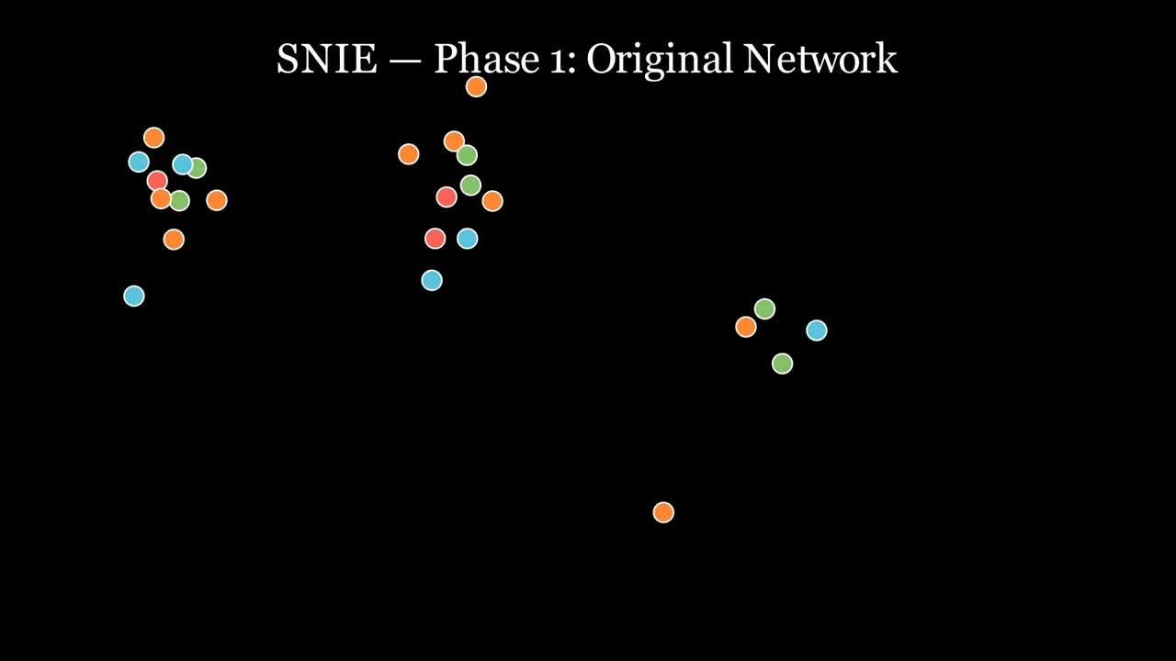
Visualization

Slide 12
Thanks

